Slide 1
Development of master curricula for natural disasters risk management in Western Balkan countries
UNIVERZITET U PRIŠTINI
KOSOVSKA MITROVICA
Dr Jelena Đokić
Fakultet tehničkih nauka
Logo of your organization
Field Monitoring 26.06.2018
Project number: 573806-EPP-1-2016-1-RS-EPPKA2-CBHE-JP
"This project has been funded with support from the European Commission. This publication reflects the views only of the author, and the Commission cannot be held responsible for any use which may be made of the information contained therein"

Slide 2
2. Curriculum Development
Development of master curricula for natural disasters risk management in Western Balkan countries
Development of aims, specific competencies and learning outcomes of master curricula in WB HEIs;
Development of courses content and sylabi;
Training of teaching staff for innovative teaching methods;
Harmonization of teaching environment with EU best practices and purchasing of laboratory equipment and literature

Slide 3
Analysis of EU master curricula
Development of master curricula for natural disasters risk management in Western Balkan countries
Overview of master´s degree programmes related to NDRM
Nation | Number of master´s degree programmes | Universities
Austria | 4 | University of Natural Resources and Life Sciences Vienna, BOKU (2) Graz University of Technology, TU Graz Vienna University of Technology, TU Wien
Greece | 1 | Technological Educational Institute of Eastern Macedonia and Thrace and Fire Brigade Academy
Italy | 4 | School of Advanced Studies IUSS Pavia, University of Patras, University of Grenoble Alpes, Middle East Technical University University of Cagliari, Interuniversity Consortium for Hydrology (CINID), Autonomous Region of Sardinia University of Thessaly, Hellenic Open University, Università degli Studi di Messina, Universitat de Barcelona University of Salemo
United Kingdom | 15 | Kings College London University College London Northumbria University Durham University University of Portsmouth Coventry University University of Huddersfield University of Manchester University of Salford University of South Wales University of Lincoln University of Leicester
Denmark | 1 | University of Copenhagen
Germany | 2 | University of Bonn Bauhaus-University Weimar
Sweden | 1 | Lund University
The Netherlands | 1 | University of Twente
Total: | 29
ANZAHL!!!

Slide 4
Catalogue of competencies
Development of master curricula for natural disasters risk management in Western Balkan countries
Requirements on employees:
Skills for an integral management of natural hazards
b) Technical know-how for necessary construction measures
c) Fundamental knowledge about valid natural hazard legislation
d) Soft skills like communication, presentation and project management

Slide 5
Catalogue of competencies
Development of master curricula for natural disasters risk management in Western Balkan countries
a) Skills for an integral management of natural hazards
a.1) Capabilities for managing multidisciplinary holistic approaches
a.2) Competences for developing and executing strategic perspectives within relevant policy and operational frameworks
a.3) Skills for planning and managing emergency and crisis situations
a.4) Competences for developing and evaluating alternatives for decision-making

Slide 6
Catalogue of competencies
Development of master curricula for natural disasters risk management in Western Balkan countries
b) Technical know-how for necessary construction measures
b.1) Holistic knowledge about typical natural hazards (Types, development, recurrence intervals, causes, etc.)
b.2) Technical understanding of constructions (Planning, designing, construction, etc.)
b.3) Skills for consideration the effects of implemented measures (short-term & long-term, up- & downstream)
b.4) Competences to find sustainable and environmental-friendly solutions

Slide 7
Catalogue of competencies
Development of master curricula for natural disasters risk management in Western Balkan countries
c) Fundamental knowledge about valid natural hazard legislation
c.1) Fundamental knowledge about national legal situation c.2) Awareness about higher-level permissions (EU Floods Directive, EU Water Framework Directive, etc.)
c.3) Knowledge about responsible institutes and authorities

Slide 8
Development of master curricula for natural disasters risk management in Western Balkan countries
Master Academic Studies – NATURAL DISASTER RISK MANAGEMENT
Title: Master engineer for protection from catastrophic events and fire

Slide 9
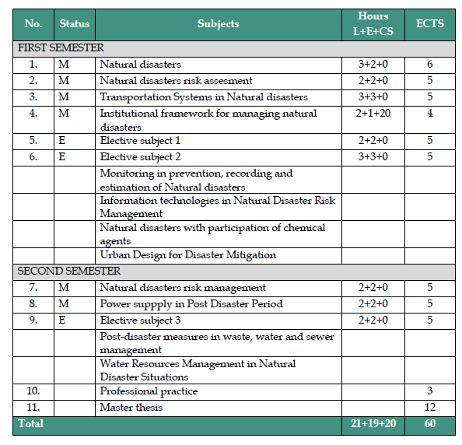
Development of master curricula for natural disasters risk management in Western Balkan countries

Slide 10
Impact
Development of master curricula for natural disasters risk management in Western Balkan countries
Masters in the field of Natural Disaster Risk Management- in line with basic needs of the society.
Competencies and qualifications which are socially justified and useful;
Experts in the managing natural disasters, by interdisciplinary and multi disciplinary approach to the problem of natural disasters, technical solutions and social responses to the disaster situations.

Slide 11
Development of master curricula for natural disasters risk management in Western Balkan countries
Complex interconnections between nature, technology and society will be part of the planning process in prevention, managing and mitigation of the natural disasters.
Soft skills Soft skills Soft skills Soft skills Soft skills Soft skills
“Lawyer”
“Manager“
“Technician”
“Lawyer”

Slide 12
Relevance of the activities to the project objectives
Development of master curricula for natural disasters risk management in Western Balkan countries
WP1 - Analysis of natural disasters needed to be managed in Western Balkan region
WP2 - Development of master curricula
WP3 - Development of trainings for citizens and public sector
WP4 - Implementation of developed master curricula and trainings
WP5 - Quality assurance and monitoring
WP6 - Dissemination
WP7- Exploitation
WP8 - Project management

